Slide 1
Chapter 4: CSS

Slide 2
Contents
Stylesheet
Accessibility
Link CSS with HTML
Syntax of CSS

Slide 3
Style sheet
Style sheet describes how documents are presented on screens, in print, or perhaps how they are pronounced
Separate structure and presentation
W3C has actively promoted the use of style sheets since 1994.
W3C recommends several stylesheets CSS1, CSS2, XPath, XSLT
CSS especially is widely implemented in browsers.

Slide 4
Advantage of StyleSheet
Simple management
  Separating of presentation result in well-organized content and simple structure.
  Construction and maintenance of the site easier.
    Change the apparence of the document easily without changing the HTML code
Consistency in the appearance of the site
Change style of a page easily
  Switch from a style for the others
  For handicap people and limited user-interface environment.

Slide 5
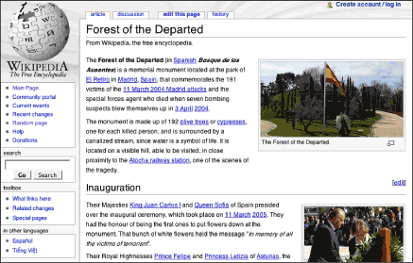
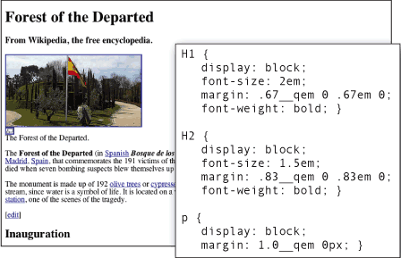
Example of page using stylesheet

Slide 6
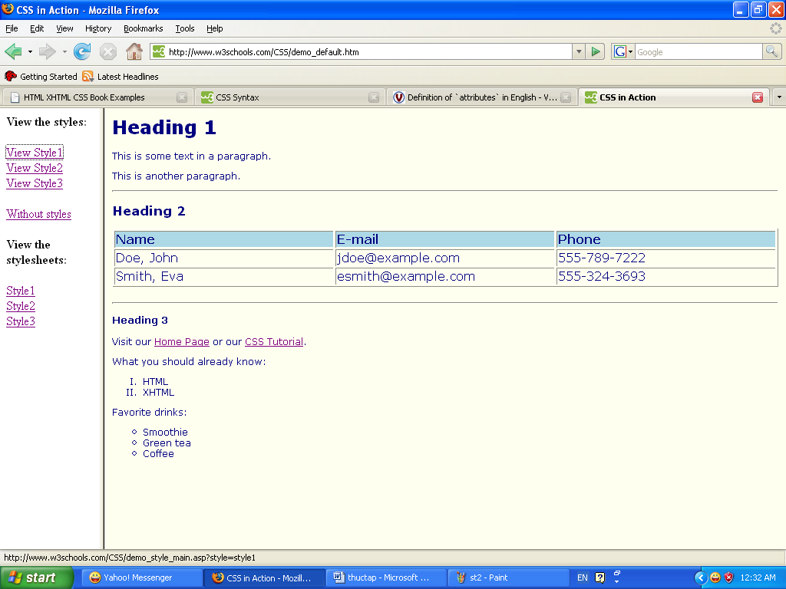
A document with different style

Slide 7
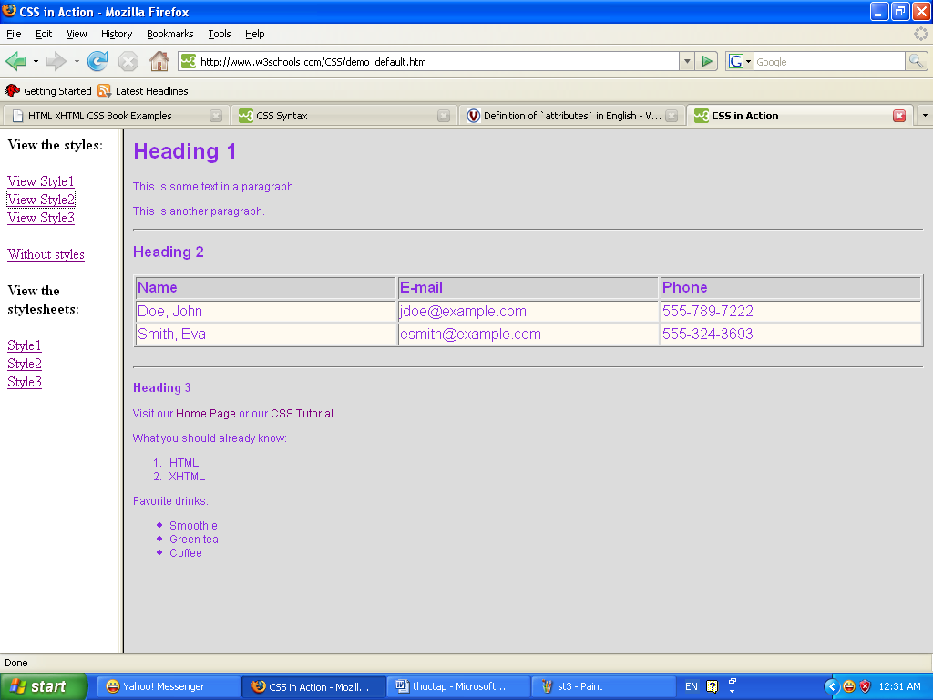
A document with different style

Slide 8
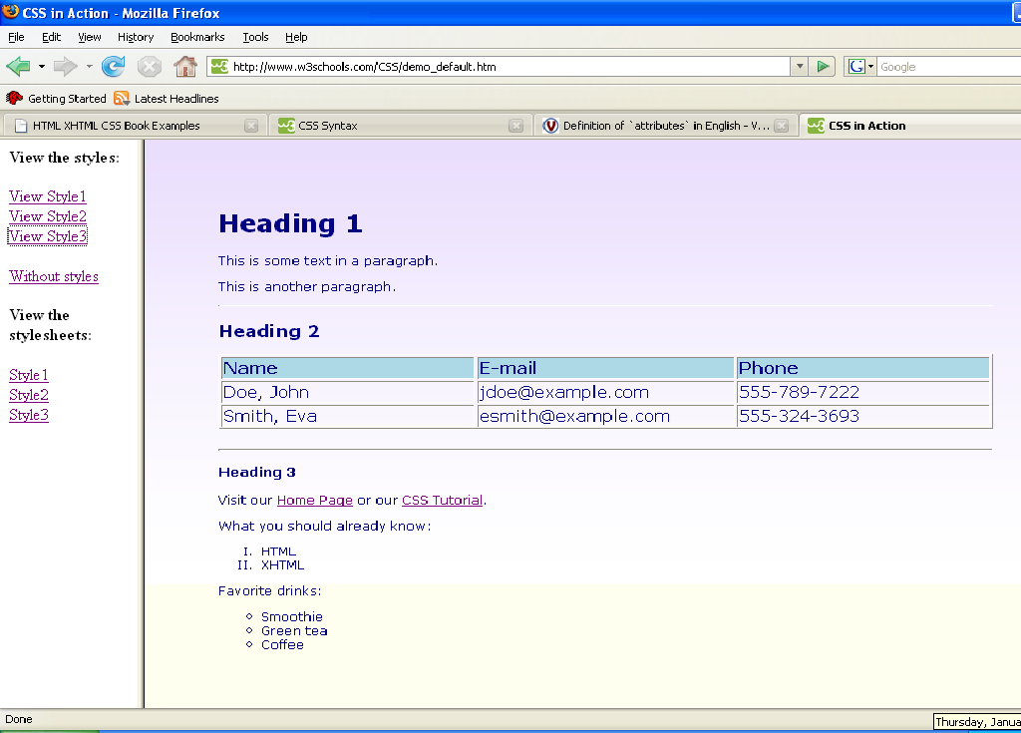
A document with different style

Slide 9
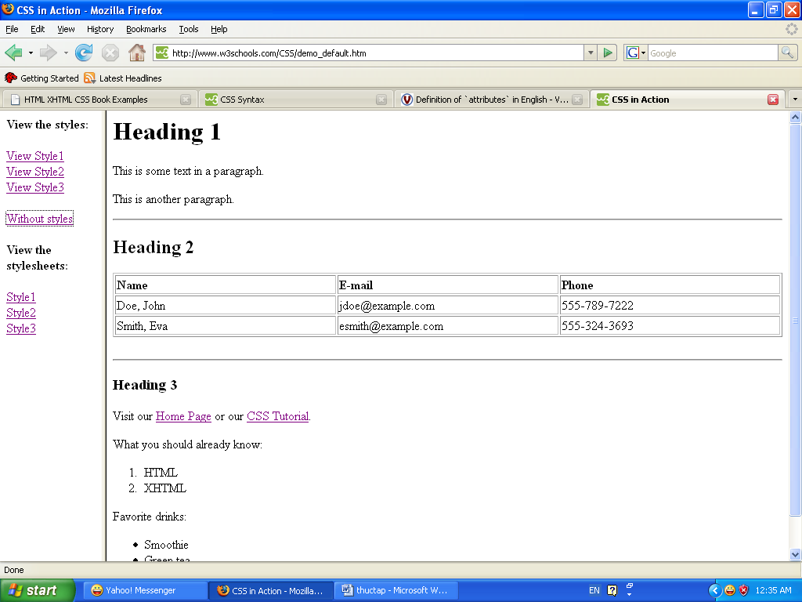
Document without style

Slide 10
Link CSS with HTML
HTML document contains content of a web page
CSS document contains the presentation style
3 ways for defining a style for a HTML
  Inline: writing styles mixing with the HTML tags
  Internal: writing CSS in a style section in the HTML document
  External: leaving CSS in a separate document and link it with the HTML document

Slide 11
Link CSS with HTML: Inline
In-line styles are plonked straight into the HTML tags using the style attribute.
<p style="color: red">text</p>
Style is applied only for the tags contaning it
in-line styles make the HTML document presentation dependant ➔should be avoided

Slide 12
Link CSS with HTML: Internal
Internal styles are used for the whole page.
Styles are defined inside the head section, surrounded by <style> tags
<html>
  <head>
  <style type="text/css">
  p {color: red; }
  a {color: blue; }
  </style>
  </head>.
  ….
This will make all of the paragraphs in the page red and all of the links blue.
Better than in-line styles, the styles and HTML code are more independent by still include in one document

Slide 13
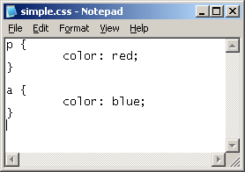
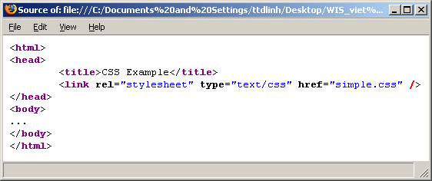
Link CSS with HTML: External
CSS document
HTML document

Slide 14
Syntax of CSS
CSS contain rules that defines styles for HTML document
  Rules define formats of information, data and presentation of the content
  Rules are associated with HTML elements
  Rules have a different syntax with HTML syntax
It is recommended that the HTML tags serving for the presentation such as <font>, <b> , <i> should be not be used

Slide 15
Rules in CSS
Rules in CSS contains
  Selector: define the object that the style will be applied
    A HTML tag, a class of HTML tag…
  Style declaration:
    Description of the style
  Syntax
    selector {attribute1: value1; attribute2: value2;
        …}
  Example
    H1 { color: blue}
  The selectors can be grouped together
    h1,h2,h3 { font-weight:bold}

Slide 16
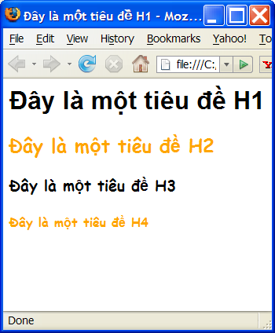
Example of rules in CSS
body { background-color: white }
h1 { font-family : sans-serif }
h2, h3, h4 { font-family : cursive }
h2, h4 { color : orange }

Slide 17
Different selectors in CSS
Selector-type
Selector-id
Selector-class
Selector universal
Selector pseudo-class

Slide 18
Selector-type
The selector is associated with a HTML tag
  selector {attribute: value}
Example
  P {font-size: large}
  All characters in the paragraph are displayed in large size

Slide 19
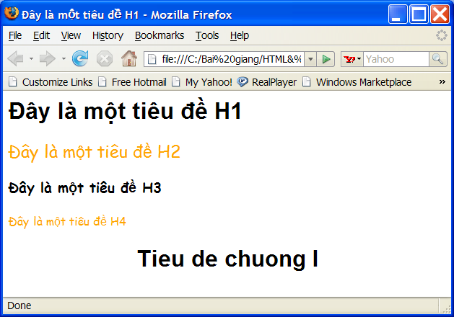
Selector-id
Selector-id
  Rule CSS applies for all HTML element that have the given ID
Syntax
#id_value
{attribute: value}
Ex:
  CSS:
  #chapter1 { text-align: center }
  HTML:
  <h1 id= chapter1> Tieu de chuong I </h1>

Slide 20
Selector-class
Rule with selector class will be applied for all HTML object that has the given class
Syntax:
  .class { attribute: value}
Example:
  CSS:
    .important {color: red}
  HTML:
    <h1 class="important”> Important title </h1>
    <p class="important”>
    This is an important paragraph.
    </p>
  All characters in <h1> and <p> are in red.

Slide 21
Selector-type và class
Selector-type and class together allows to defines rules for some tags with a given class attribute
Syntax
  Tag.class { attribute: value}
Ex
  CSS:
  p.important { color: red; }
  p.brazil {
      color: green;
      background-color: yellow;
  }
  HTML:
    <h1 class="important> Tieu de quan trong </h1>
    <p class="important> Vi du mot doan quan trong. </p>
    <p class=“brazil”> Mau co Brazil </p>
    <p> Day la mot doan khac </p>

Slide 22
Selector-universal
Style with Selector-universal is applied for all objects
Syntax
  * {attribute: value; }
Example
  *{font-size: large;}

Slide 23
Selector Pseudo-class
Pseudo-class is used to add special effects to a selector when there is user interaction
  Syntax
    selector:pseudo-class {attribute : value}
    selector.class:pseudo-class {attribute : value}
  Ex
    a:visited {color: red} /* visited link */
    Display in red all visited links.

Slide 24
Selector Pseudo-class
Pseudo-class
  :active
    The pseudo-class that corresponds to the action when user click on the object given in the selector: button, link
  :hover
    The pseudo-class that corresponds to the action when users move th cursor over the selector
  :link
    selector is a link that have not visited
  :visited
    Selector is a link that is visited

Slide 25
Selector Pseudo-class
Ex:
  a:link { color: red }
  a:visited { color: green }
  a:hover { background-color: yellow }
  a:active { background-color: pink }

Slide 26
Comment in CSS
Chú thích trong code
Begin with "/*“ and end with "*/“
Ex:
  File CSS:
  /* This is a comment */
  p {
  text-align: center;
  /*This is another comment */
  color: black; font-family: arial
  }

Slide 27
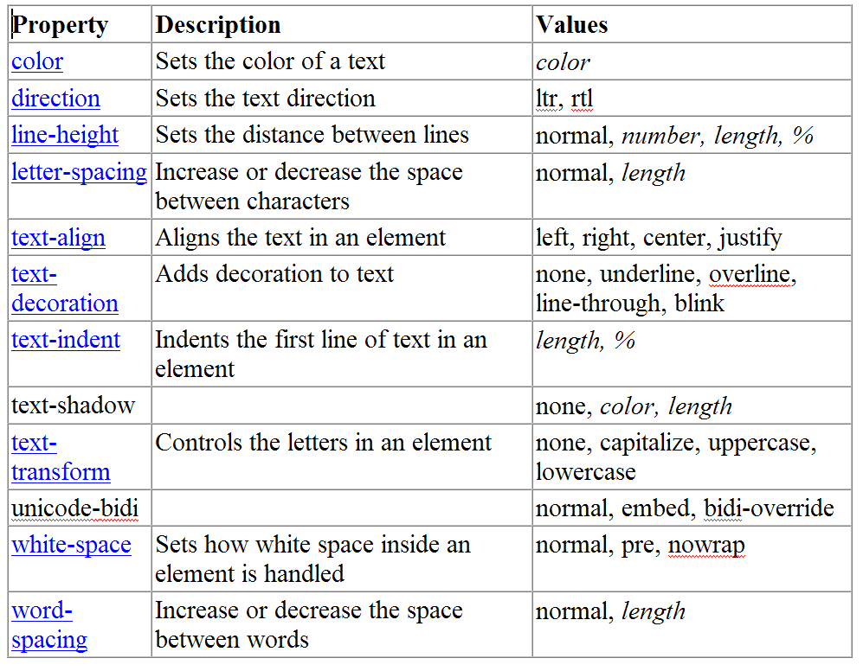
CSS attributes for text

Slide 28
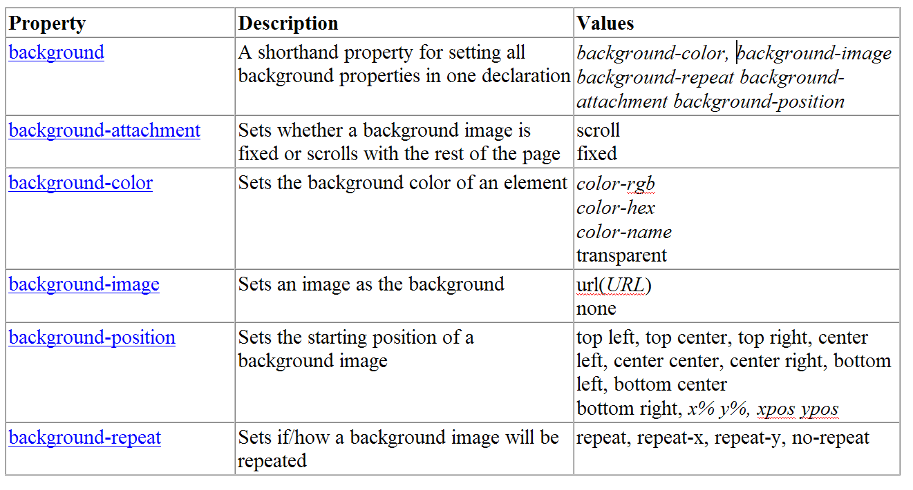
CSS attributes for background

Slide 29
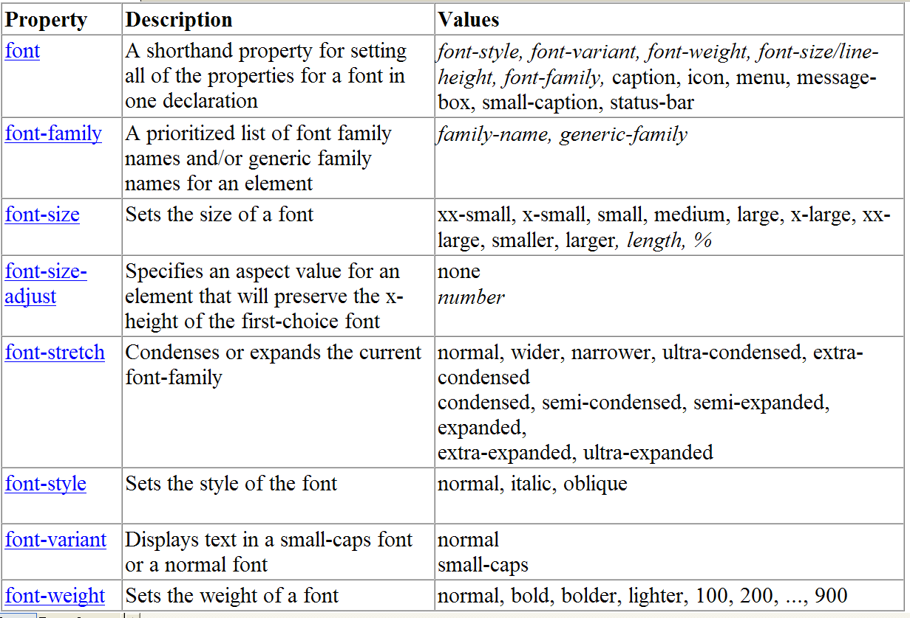
CSS attributes for font

Slide 30
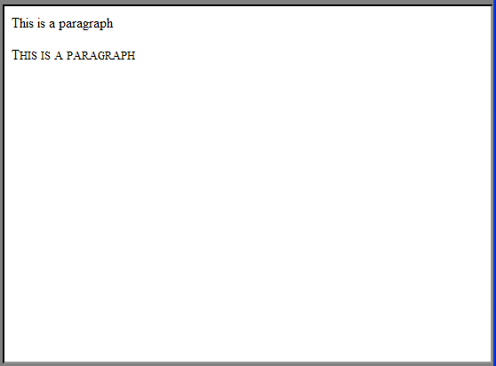
Example
<html>
<head>
<style type="text/css">
p.normal {font-variant: normal}
p.small {font-variant: small-caps}
</style>
</head>
<body>
<p class="normal">This is a paragraph</p>
<p class="small">This is a paragraph</p>
</body>
</html>

Slide 31
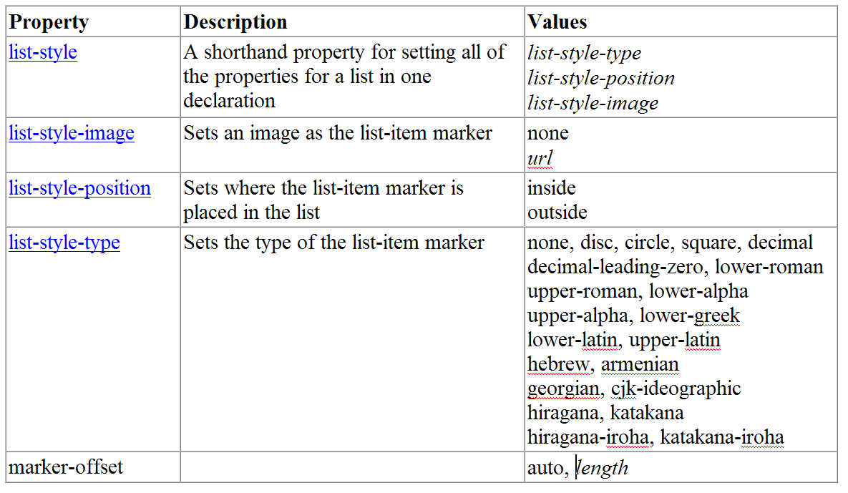
CSS attributes for list

Slide 32
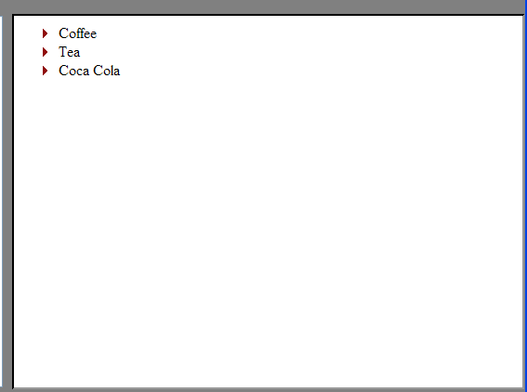
Example
<html>
<head>
<style type="text/css">
ul
{
list-style-image: url('arrow.gif')
}
</style>
</head>
<body>
<ul>
<li>Coffee</li>
<li>Tea</li>
<li>Coca Cola</li>
</ul>
</body>
</html>

Slide 33
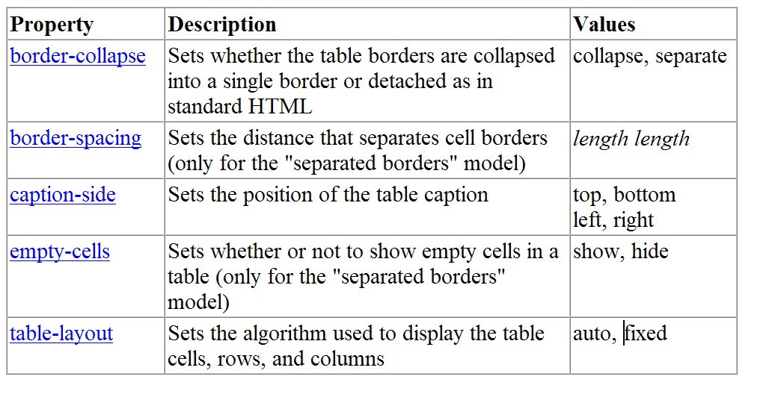
CSS attributes for table

Slide 34
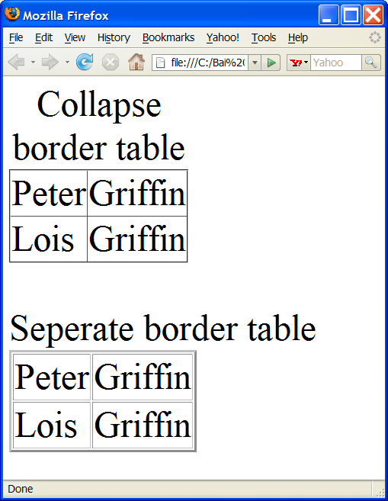
Example
<html>
<head>
  <style type="text/css">
  table.coll { border-collapse: collapse }
  table.sep { border-collapse: separate }
  </style>
</head>
<body>
  <table class="coll" border="1">
  <tr> <td>Peter</td> <td>Griffin</td> </tr>
  <tr> <td>Lois</td> <td>Griffin</td> </tr>
  </table>
  <br />
  <table class="sep" border="1">
  <tr> <td>Peter</td> <td>Griffin</td> </tr>
  <tr> <td>Lois</td> <td>Griffin</td> </tr>
  </table>
</body>
</html>

Slide 35
Frame model
Some HTML elements are displayed in a frame
  H1, h2, p, ul, li, div
Khung
Top margin
padding
Day la mot doan van ban nam trong khung. No cach border cua khung cac doan padding. Day la mot doan van ban nam trong khung. No cach border cua khung cac doan padding.
left margin
padding
padding
Right margin
padding
bottom margin

Slide 36
Frame model- Border
The border of the frame can be displayed with different color and style
Characteristic of the border
  Width : width of the border
    thin,
    medium,
    thick
  Style : style of the border
    solid,
    dashed,
    dotted, etc
  Color: color of the border

Slide 37
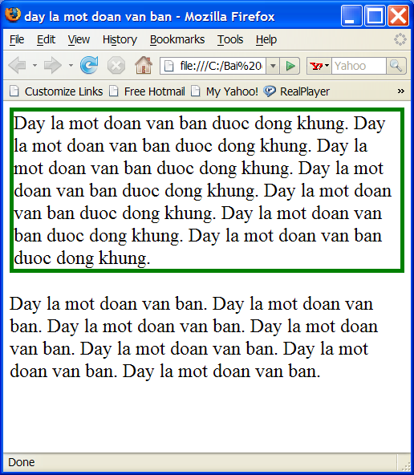
Frame model- Border
Example
  p.special
    {
    border: thick solid green;
    }
width
style
color

Slide 38
Frame model- Border
Characteristic of the border can be defined with different attribute:
  border-width
  border-style
  border-color
The previous example is equivalent with:
  p.different
  {
  border-width: thick;
  border-style: solid;
  border-color: green;
  }

Slide 39
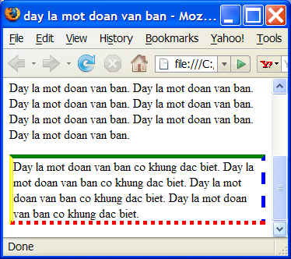
Frame model - Border
Four edges of the border can be displayed differently
Each attributes have 4 values corresponding to 4 edges of the border
Ex:
p.four_borders
{
border-width: thick;
border-style: solid dashed dotted double;
border-color: green blue red yellow;
}

Slide 40
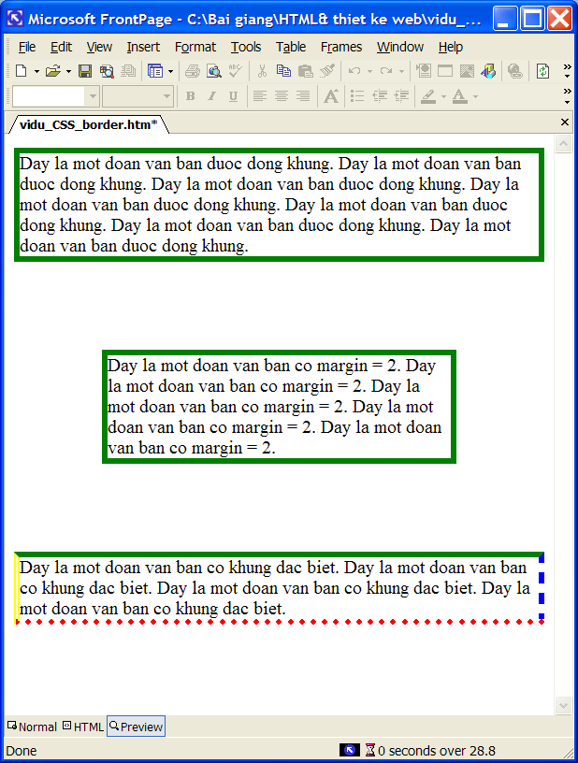
Frame model- Margin
p.conclu
{
margin: 2cm 2cm 2cm 2cm;
}
This rule is equivalent with
p.intro
{
margin-top: 2cm;
margin-left: 2cm;
margin-right: 2cm;
margin-bottom: 2cm;
}
Default value of the margin is 0.
Values of margin can be defined by %.

Slide 41
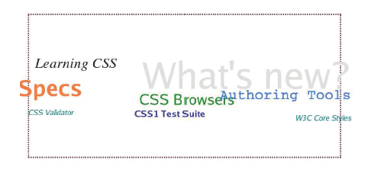
Frame model- Margin
Values for margin can be <0, it makes text overlapping
p { margin : 5px 10% -5px;}

Slide 42
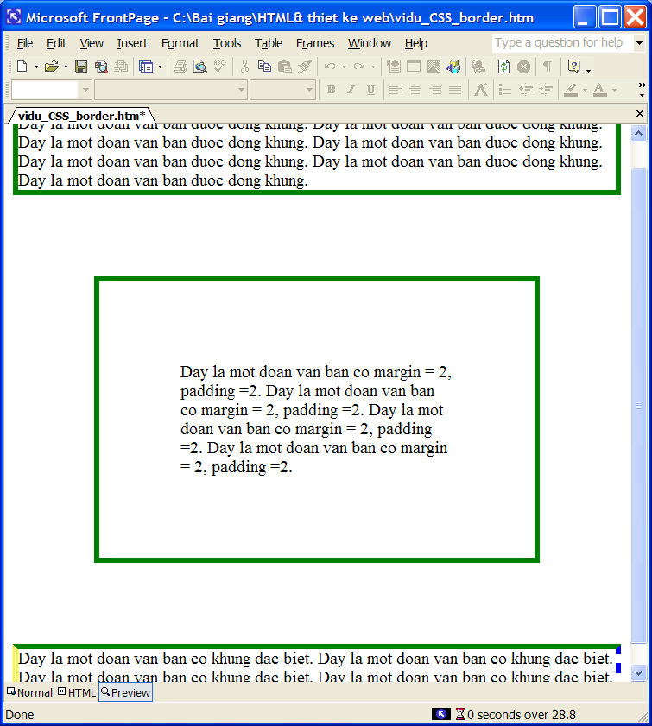
Frame model - Padding
Padding define the distance between the content and the border
Attributes of padding are defined similarly to margin, howerverthe value cannot be negative
p.intro
{
padding-top: 2cm;
padding-left: 2cm;
padding-right: 2cm;
padding-bottom: 2cm;
}
Equivalent to:
p.conclu
{
padding: 2cm 2cm 2cm 2cm;
}

Slide 43
Frame model - Alignment
Attribute text-align allows to align the text within a frame
Text-align can be: left, right, center, justify
Ex:
p.intro
{
text-align: right;
}
p.conclu
{
text-align: justify;
}

Slide 44
Frame model - Indentation
Indentation attributes allow defining the right shift space at the beginning of the line
Ex
  p
  {
  text-indent: 1cm
  }
All paragraphs are 1cm right shift

Slide 45
Frame model- line-height
line-height defines the height of a line including the height of its characters and the space with another line
Ex:
  p.p2
  {
  line-height: 1.5;
  }

Slide 46
Frame model – width, height
Width and height define the width and the height of a frame
Width and height can receive values in
  Number of pixel: 300px
  Cm : 5cm
  %, relative values with the width or the height of browser window. Ex: 50%

Slide 47
Division
<Div> define a regions of code in HTML file
<div id =“…”>
….
</div>
Tag <div> is used to divide a HTML file in zone for applying different styles for each zone later
Ex:
<html>
<body>
<div id = “modau”> …</div>
<div id = “noidung”>…</div>
<div id =“ketluan”>…</div>
</body>
</html>

Slide 48
Frame model: Float
Float defines how a HTML element should be aligned in comparison with its parent.
Ex:
  CSS:
    #section2 {
    float: right;
    width: 300px;
    background-color: yellow;
    }

Slide 49
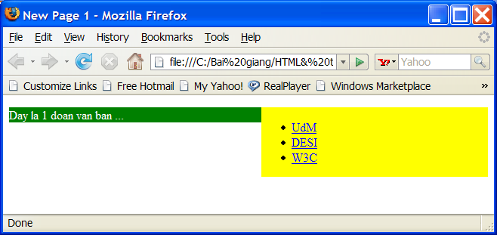
Frame model: Float
  HTML:
  <body>
  <div id=“section2">
    <ul>
    <li><a href="http://umontreal.ca"> UdM</a>
    </li>
    <li><a href="http://desi.umontreal.ca"> DESI</a>
    </li>
    <li><a href="http://w3.org"> W3C</a>
    </li>
    </ul>
    </div>
  <div id=“section1">
  <p> Day la mot doan van ban. ...
  </p>
  </body>
section2 is aligned in the right of <body> and pushing the content to the left.

Slide 50
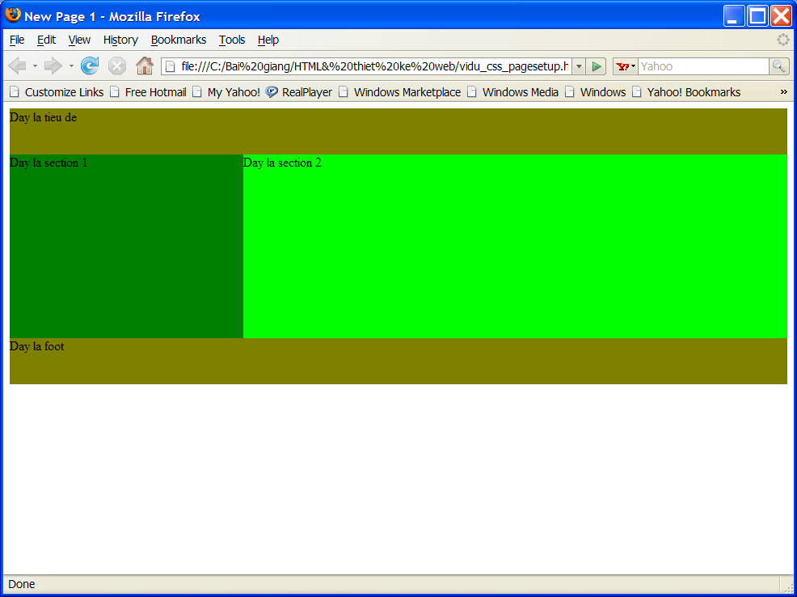
Page formatting
Left column occupies 30% page width
#section1
{
float:left;
width: 30%;
}
#section2
{
float:right;
width: 70%;
}
Head and foot sections are not floating and occupy all the page width
#foot, #header
{
clear:both;
width: 100%;
}

